Slide 1


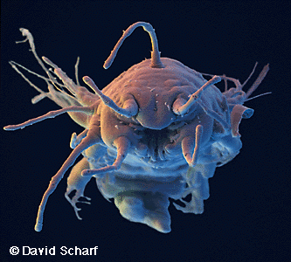
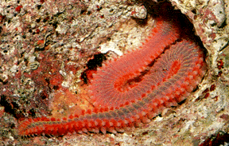
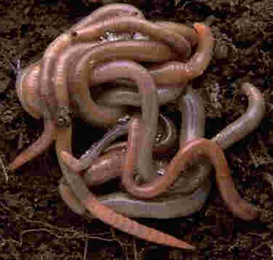
BASRAH UNIVERSITY
Faculty of Education for Pure Sciences
Biology Department
2025- 2026
Phylum Annelida
The Segmented Worms
Presented By: Prof. Dr. Sabeeh H. AL-Mayah

Slide 2
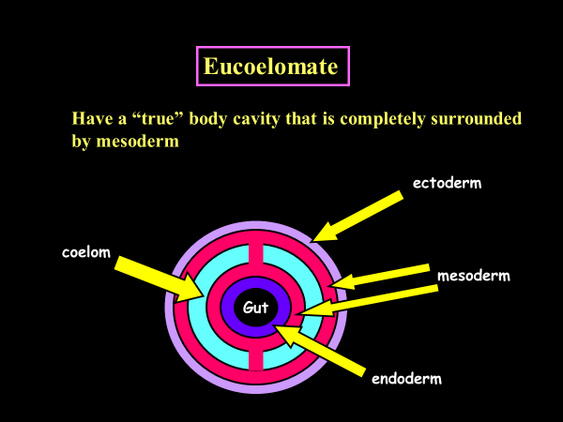
Annelida Characteristics
Protostome
Development is characterized by:
blastopore becomes the mouth
Spiral cleavage
Determinant development
Schizocoelus coelom development (eucoelom)
Coelom is closed fluid filled cavity that surround the gut.
Mesodermal membranes (mesenteries) suspend organs in the coelom.

Slide 3
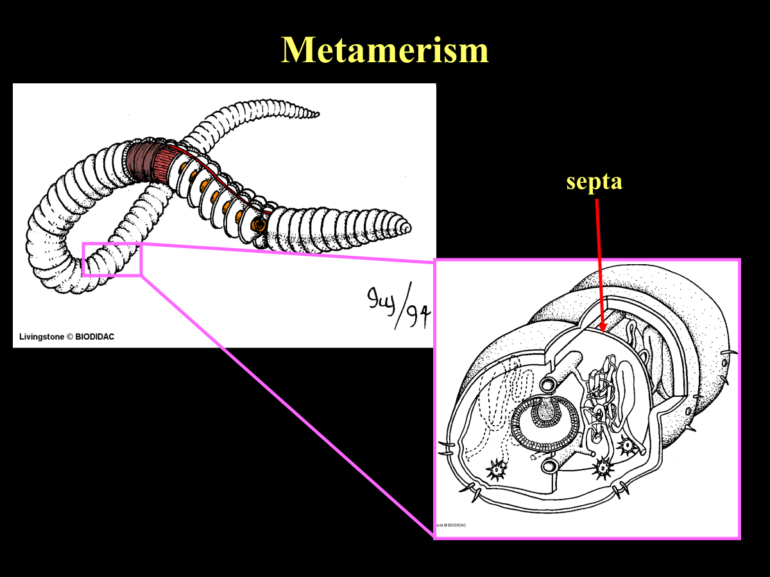
Annelida Characteristics
Metamerism
The body is made up of serially repeating, coordinated segments called metameres that are separated from one another by septa.
Each metamere contains sets of repeating organs
e.g. blood vessels, nerve cord, excretory organs

Slide 4
Metamerism means
1-That the body of animal is made up of an approximately fixed number of similar segments, and that no new segments are added to the adult animal .
2- All segments should be of one age and the same degree of maturity and formation.
3- There must be a close functional interdependence between the different segments, without each of them having an independent existence.
Benefits or adaptive advantages of a metameric body plan
greater flexible support .
more efficient locomotion .
specialization of body regions (segments)… this specialization is called tagmatization .

Slide 5
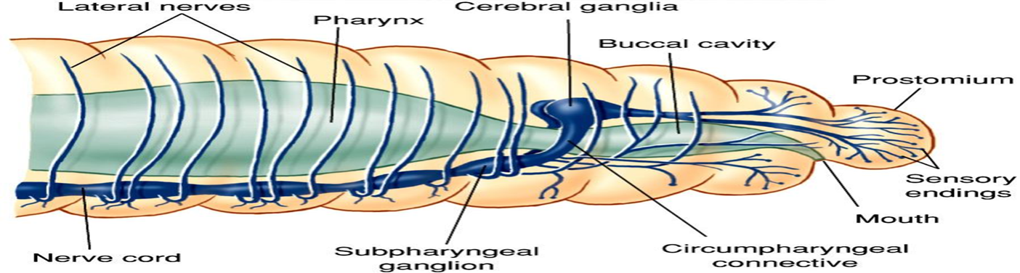
Nervous system
2 cerebral ganglia
a ventral nerve cord with 2 ganglia per metamere.
In some species, sensory organs such as eyes, palps, and tentacles have arisen

Slide 6
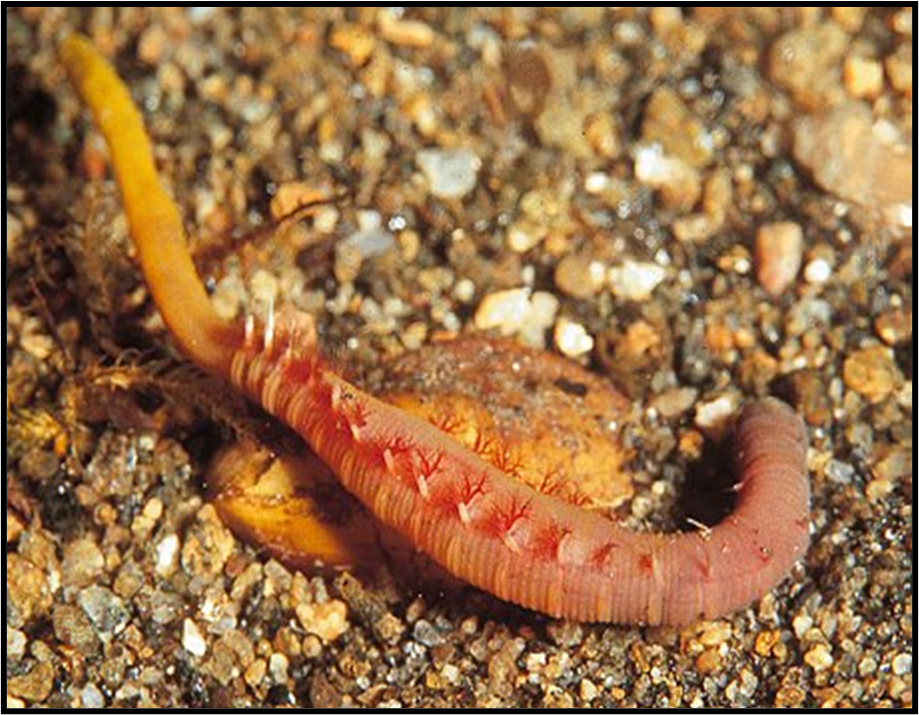
Locomotion
both longitudinal and circular muscles
most have chaetae [setae] (chitinous bristles secreted by the epidermis) that aid in
locomotion and burrowing
Skeletal System
fluid in coelom acts as a hydrostatic skeleton
Gas exchange
mainly by diffusion
Class Polychaeta often has specialized structures for
gas exchange (e.g. parapodia, gills).

Slide 7
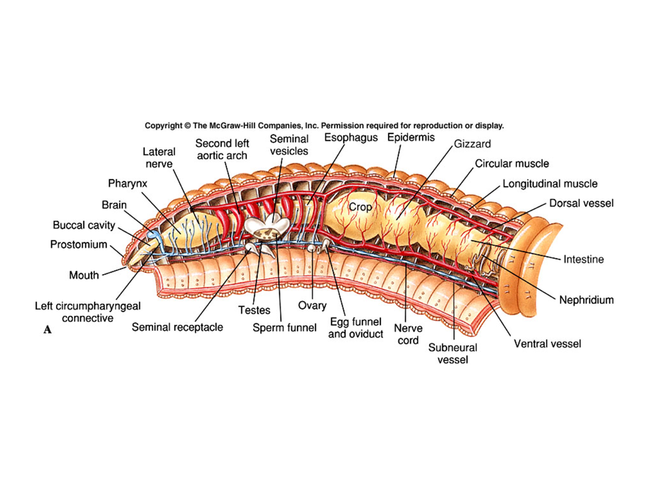
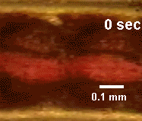
Digestive System
complete
regional specialization
Reproduction
Predominantly sexual
Circulatory System
closed circulatory system composed of blood
vessels (some of which are contractile and act as "hearts”)
some circulation is also accomplished by the coelomic
fluid

Slide 8
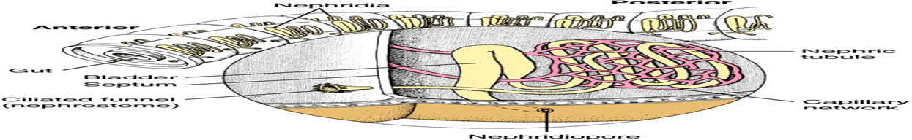
Excretion
excretion is accomplished by organs called nephridia (singular nephridium)

Slide 9
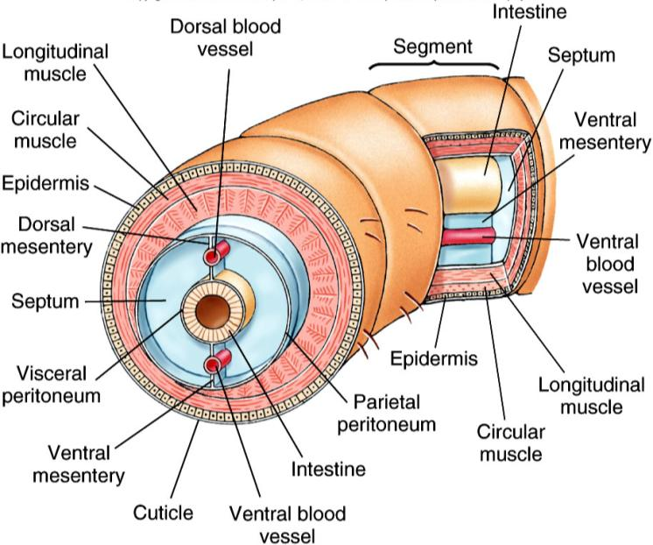
Annelid Body Plan
Setae
Notes:
Fig. 17.1

Slide 10
Phylum Annelida
Class Polychaeta
Class: Clitellata
Subclass: Oligochaeta
Subclass: Hirudinea

Slide 11
Class Polychaeta
most primitive of the annelids many bristles, marine.
largest class of annelids with 5300 species
many are members of the infauna buried in muds or sands and secrete mucus/CO₃ materials (Often tube-dwelling ).
many other species form tubes on the surface of the substrate, members of the epifauna
5. Highly specialized head regions
Antennae
Sensory palps
Feeding appendages

Slide 12
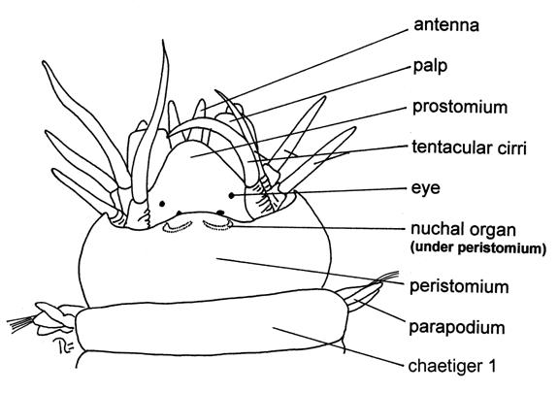
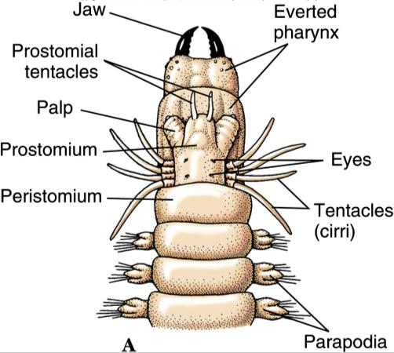
6. prostomium – this is the lobe that projects out before the mouth and has sensory organs located on it (eyes, antennae, palps, and nuchal organs)
7. peristomium – literally “around the mouth” – this is the first body segment at it surrounds the mouth

Slide 13
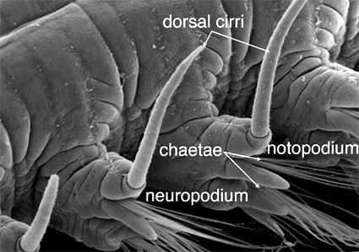
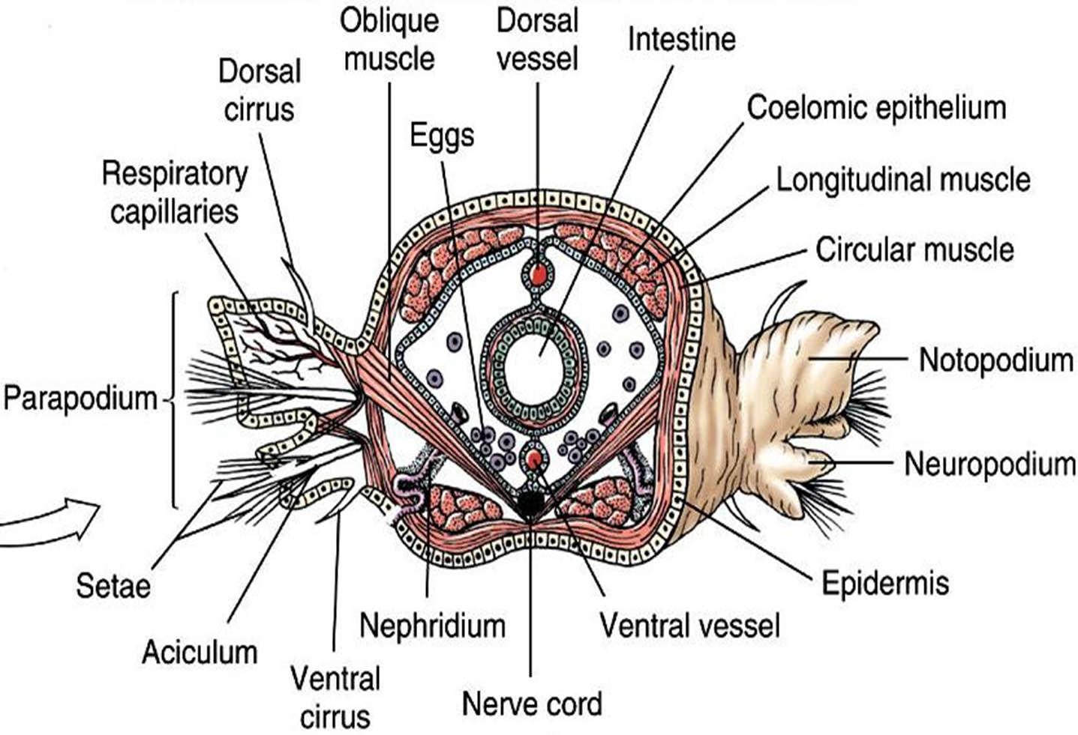
8. the most distinctive features are the presence of lateral extensions called parapodia.
the parapodia terminate in setae or bristles at their tips.
aid in locomotion.
aid in burrowing .
Some are venomous and aid in defense.

Slide 14
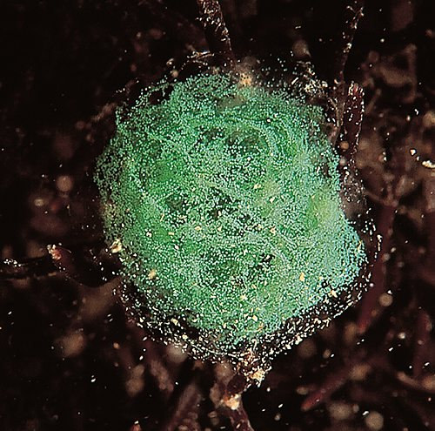
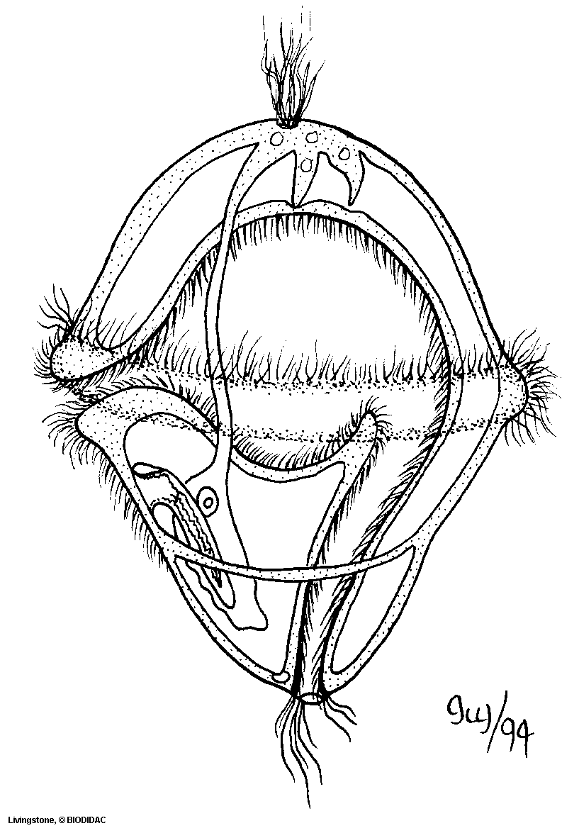
Reproduction
usually, dioecious.
no permanent sex organs; gametes are shed into coelom.
fertilization is usually external.
indirect development → trochophore larvae.
Notes:
1st phyla we will talk about and what we will cover in the lab today is…

Slide 15
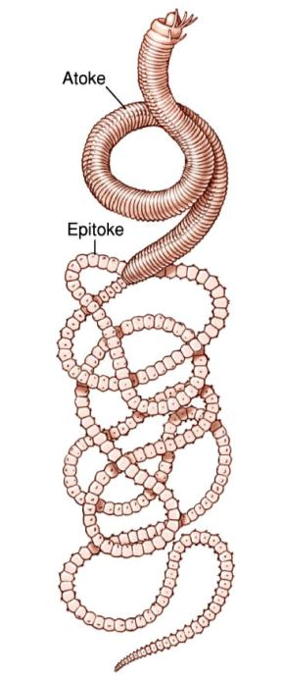
Polychaete Reproduction
Epitoky
In some species, the rear portion of the worm (“epitoke”: carries the eggs or sperm), breaks off from the body and swims to the surface to reproduce. The remaining benthic worm (“atoke”) continues to feed and grow and will eventually produce new epitokes.
To synchronize these spawning, this swarming
behavior is usually triggered by the full moon.

Slide 16
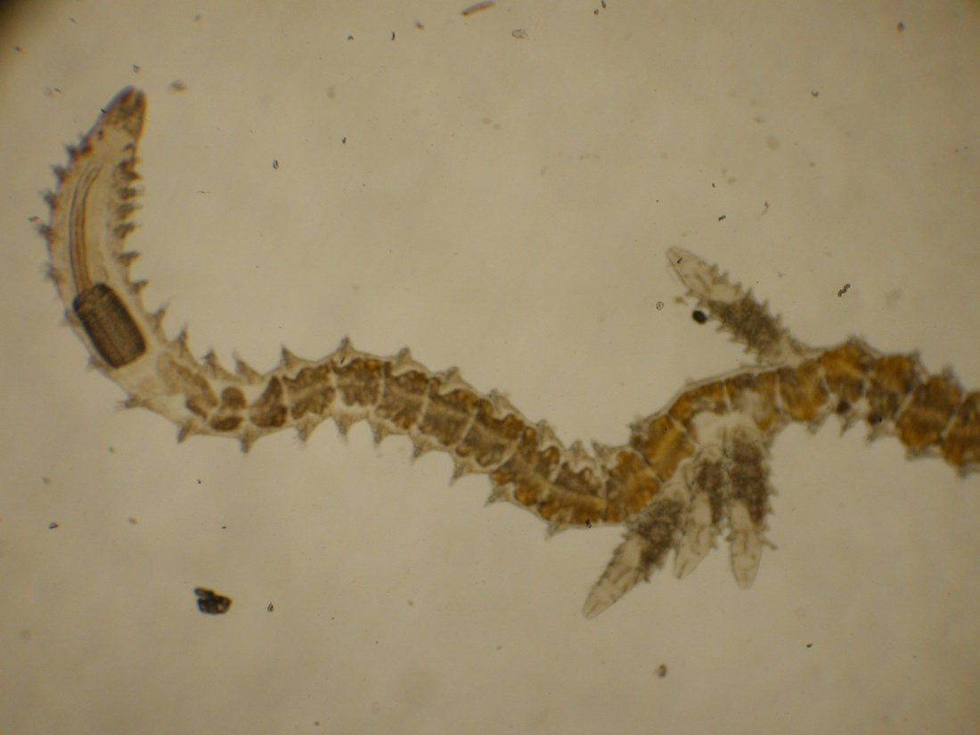
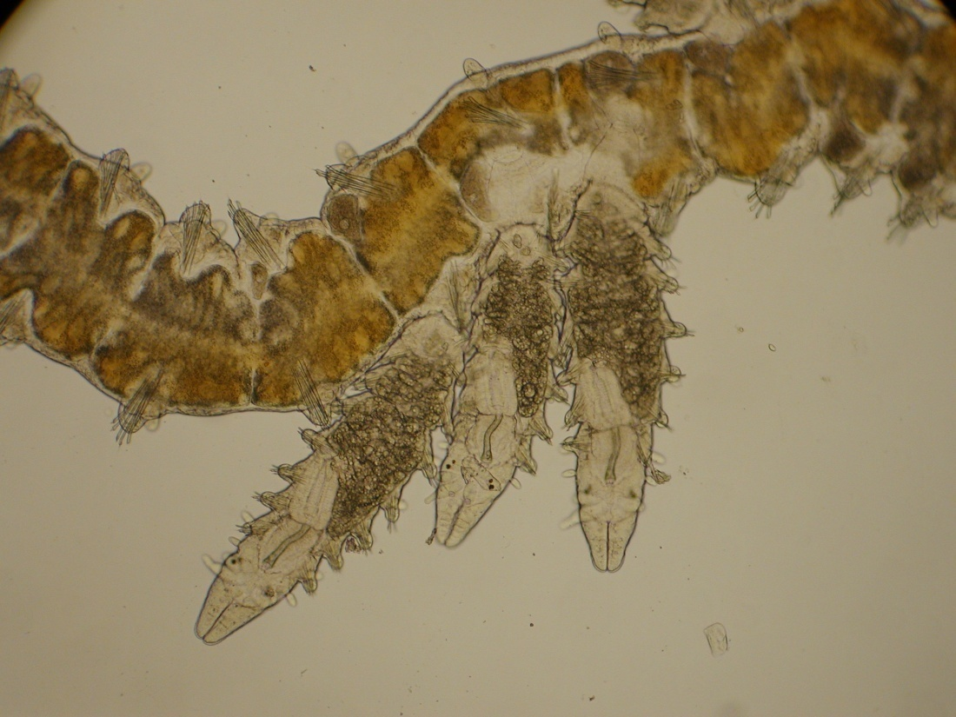
Class Polychaeta
Reproduction
asexual
Epitokes
Notes:
1st phyla we will talk about and what we will cover in the lab today is…

Slide 17
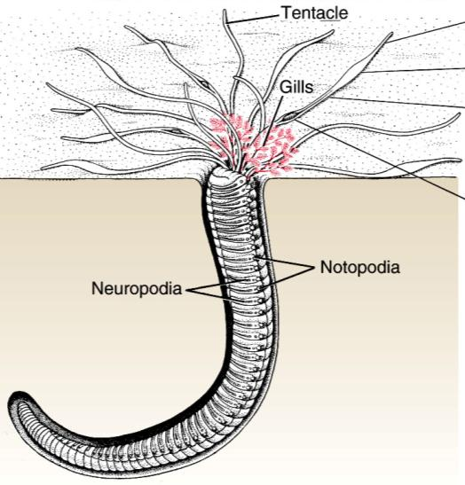
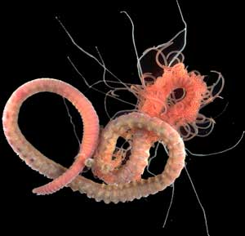
Polychaeta
Amphitrite
Notes:
Fig. 17.4

Slide 18
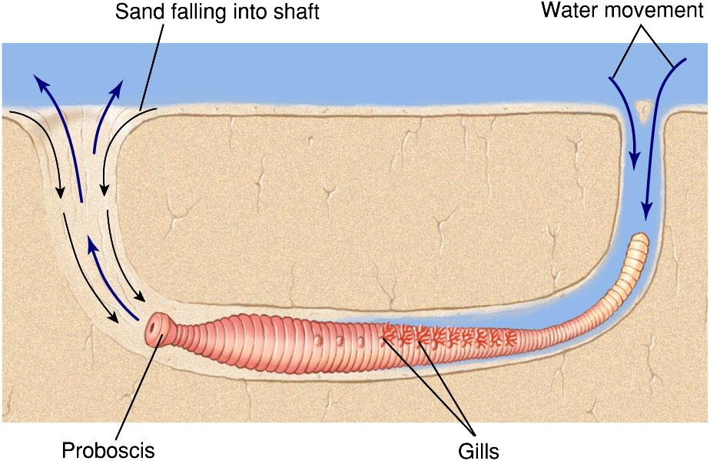
Polychaeta
Lugworm (Arenicola sp)
Notes:
Fig. 17.5

Slide 19
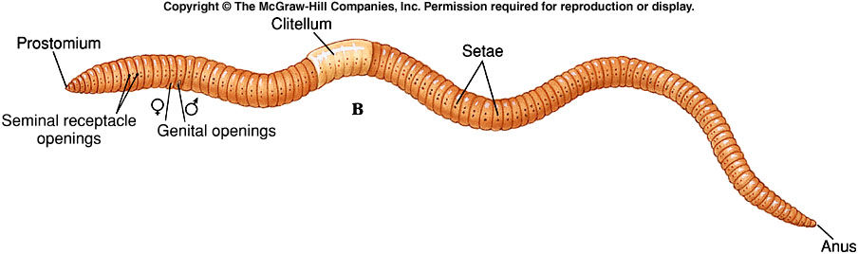
Class Oligochaeta
terrestrial, freshwater , and few marine.
have few setae (Oligo = few, chaeta = setae).
usually feed on detritus (decaying organic matter).
have specialized digestive system to obtain the maximum amount of nutrients out of the detritus (e.g. typhlosole, gizzard, crop…).
Notes:
Fig. 17.12b

Slide 20
Upon careful examination of the worm, the followings opening can be observed : 1-themouth. 2-the anus. 3-Dorsal pores, the first opening located in the middle line starting from the 8 th or 9 th segment to the end of the body. 4-excretory pores, nephridiopores which form tow rows in the ventral side. A pair in each segment except through the first three segments and the last. 5- male genital opening are a pair of slit openings on the ventral side of segment 15. 6- female genital openings are tow small round opening located on the ventral side of segment 14. 7- openings of seminal receptacles these are a pair of small openings located between 9,10 segments and 10,11 segments .These belong to the genital reservoirs in which a worm participating sperms from the other worm involved in the mating process .

Slide 21
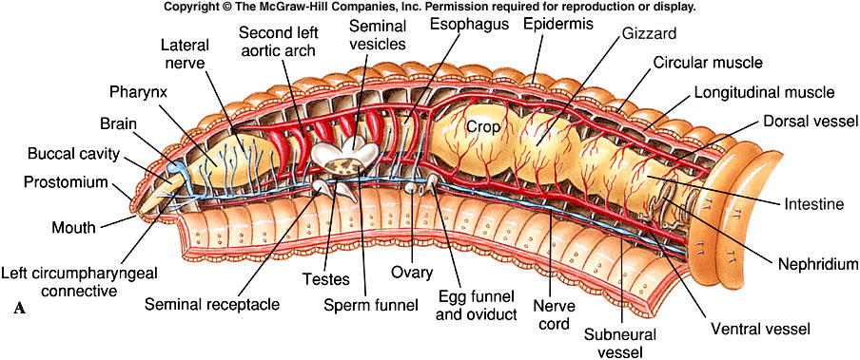
Oligochaete Anatomy
Notes:
Fig. 17.12a

Slide 22
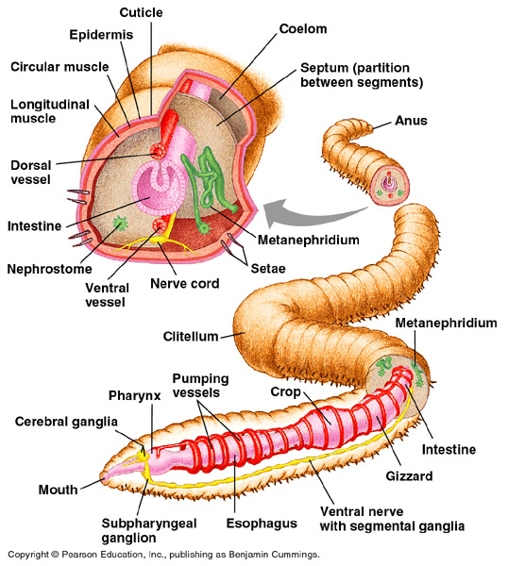
Earthworm

Slide 23
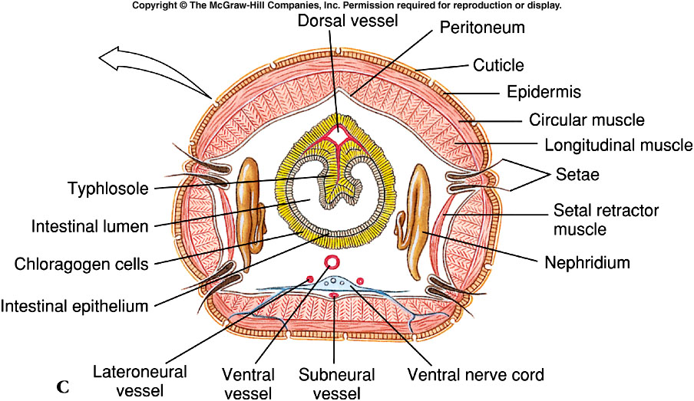
Oligochaete Anatomy
Notes:
Fig. 17.12c

Slide 24
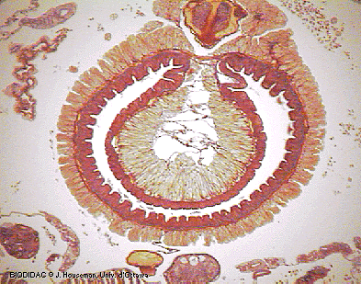
Class Oligochaeta
Typhlosole :
infolding of the dorsal side of the intestine.
increases surface area for absorption of nutrients
typhlosole
gut

Slide 25
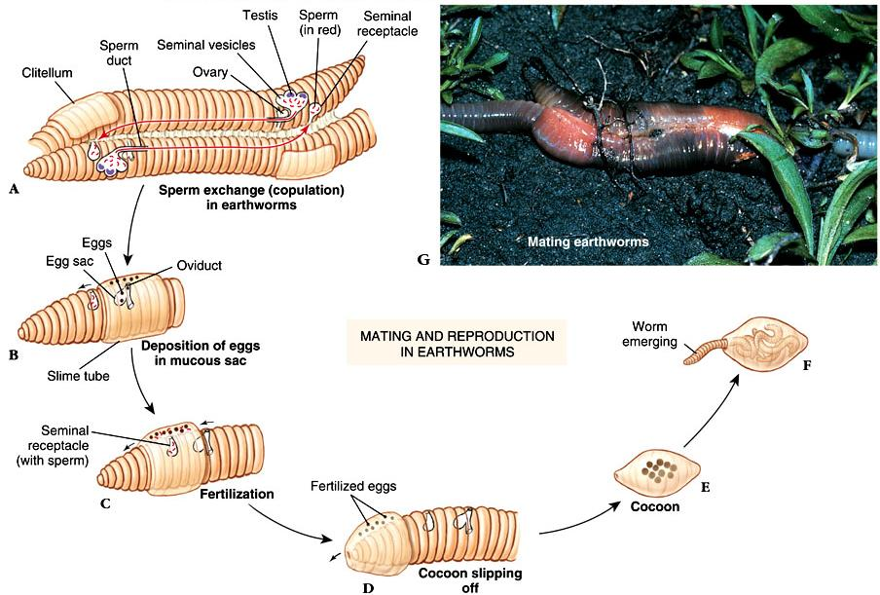
Oligochaete Reproduction
Notes:
Fig. 17.Fig. 17

Slide 26

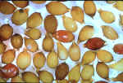
Earthworms Secret Cocoons Where They Store Their Eggs!

Slide 27
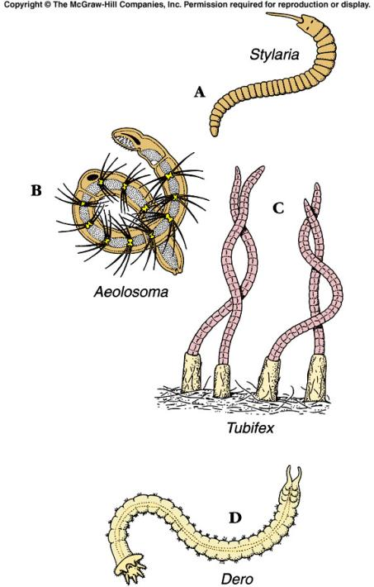
Aquatic Oligochaetes
Notes:
Fig. 17.18

Slide 28
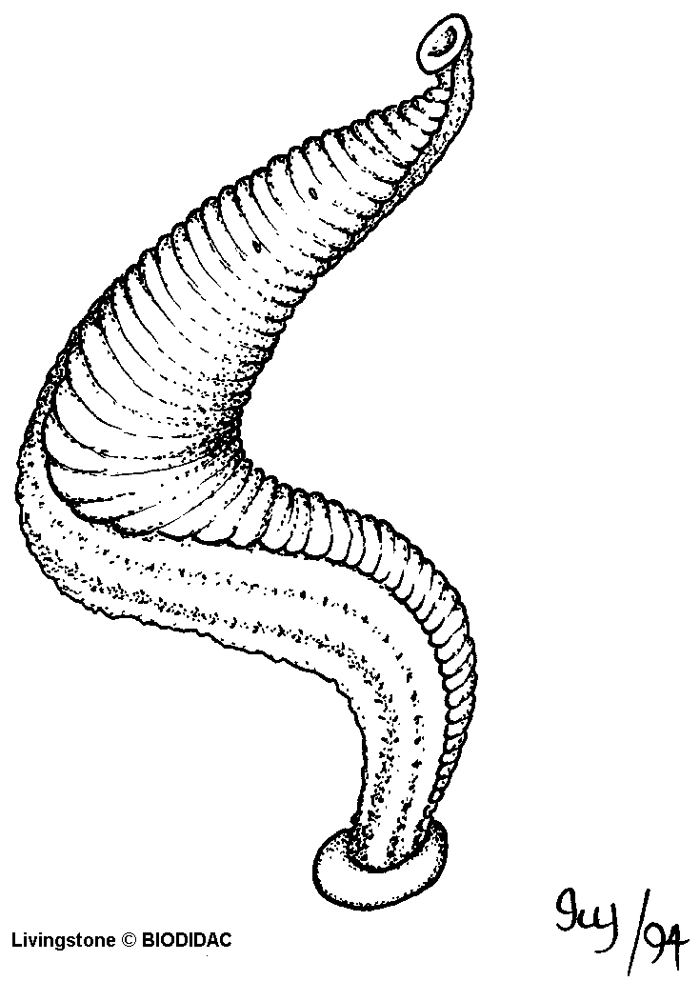
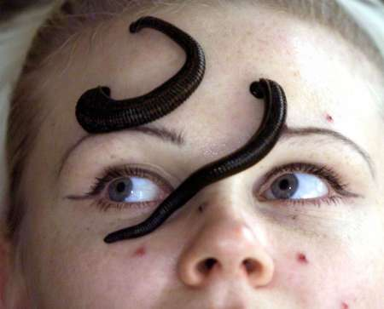
Class Hirudinea ( Leeches )
usually freshwater but there are some marine and terrestrial species
Fixed segments (34)
no septa between metameres
no setae
have 2 suckers
1 metamere
annuli

Slide 29
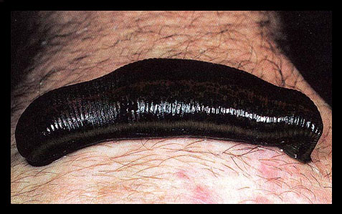
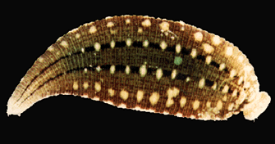
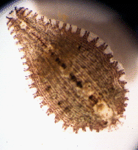
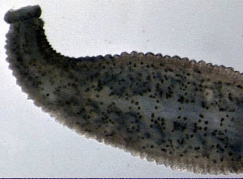
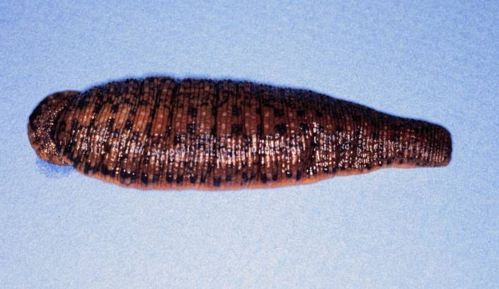
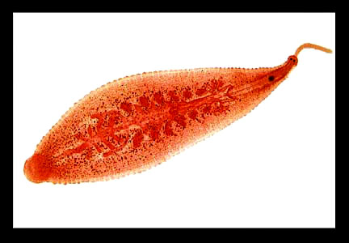
Class Hirudinea
Notes:
1st phyla we will talk about and what we will cover in the lab today is…

Slide 30
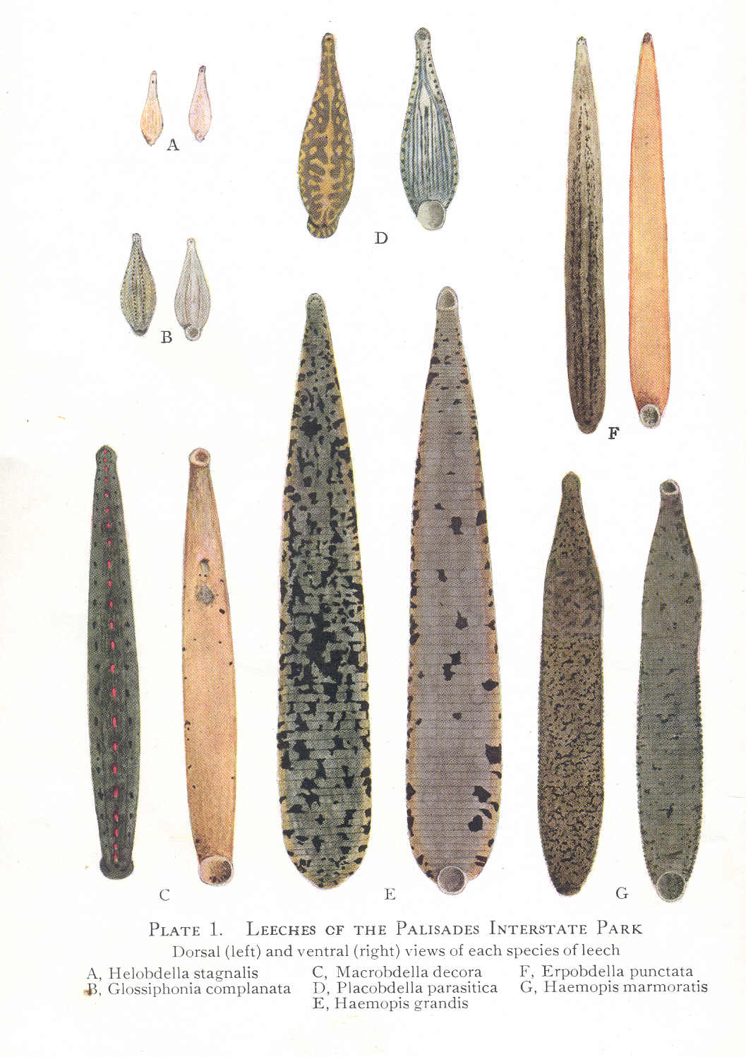

Slide 31
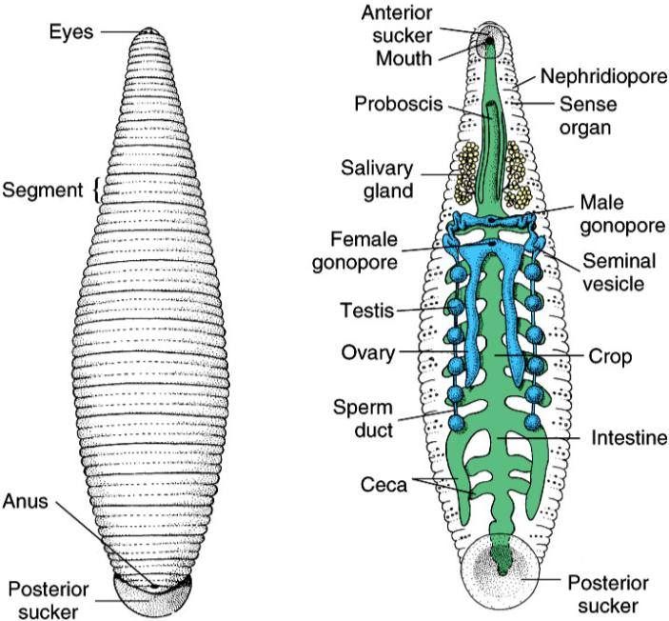
Class Hirudinea
Notes:
Fig. 17.20

Slide 32
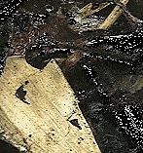
Class Hirudinea
Locomotion
Lack septa between metameres, so they are incapable of moving like Oligochaetes. Instead, they use their anterior and posterior suckers to move.
Notes:
1st phyla we will talk about and what we will cover in the lab today is…

Slide 33
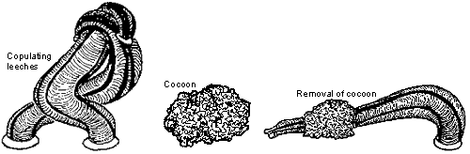
Reproduction
usually, monoecious
cross-fertilize by exchanging sperm
Erpobdellid Leeches secrete a protective cocoon, cement it to the substrate and sometimes ventilate it before they leave the egg capsules.

Slide 34
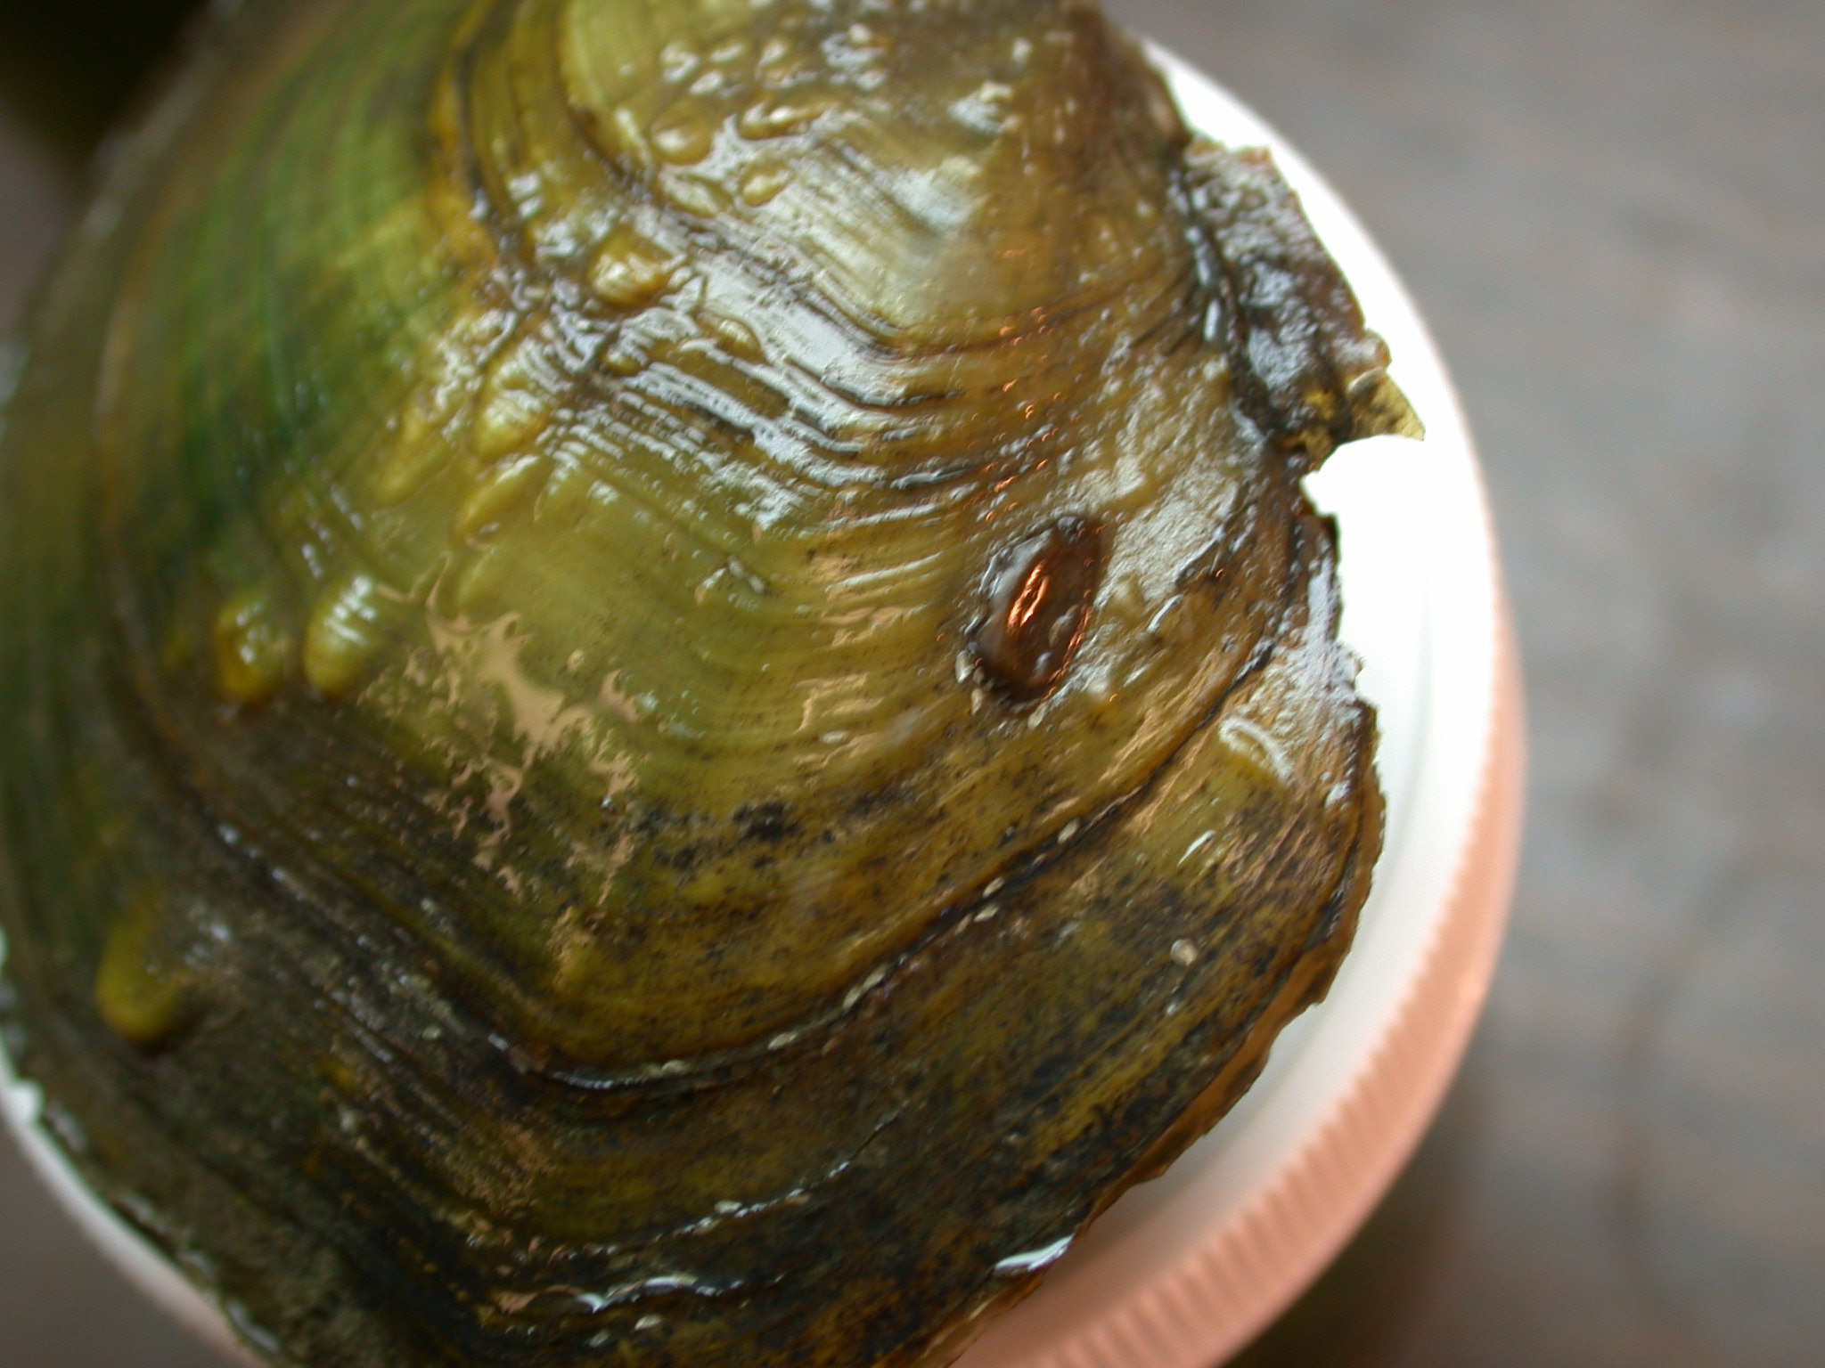
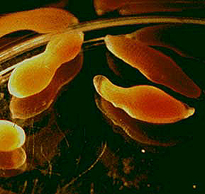
Hirudinad Leeches (the jawed leeches) deposit desiccation-resistant cocoons on land.
LEECH CACOON ON BIVALVE SHELL.

Slide 35
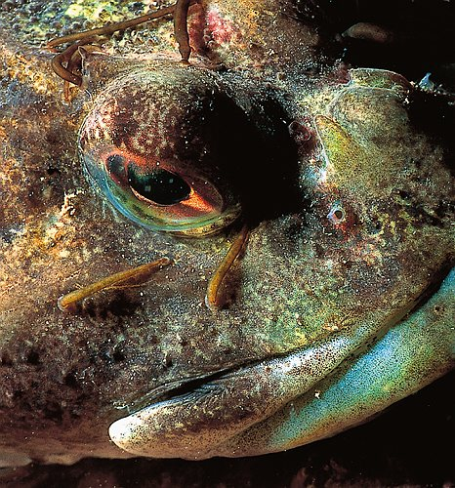
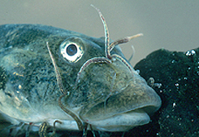
Ecology
Although some leeches are parasitic blood suckers (can be temporary or permanent), many (most) are predators on gastropods and bivalves.
Notes:
1st phyla we will talk about and what we will cover in the lab today is…

Slide 36
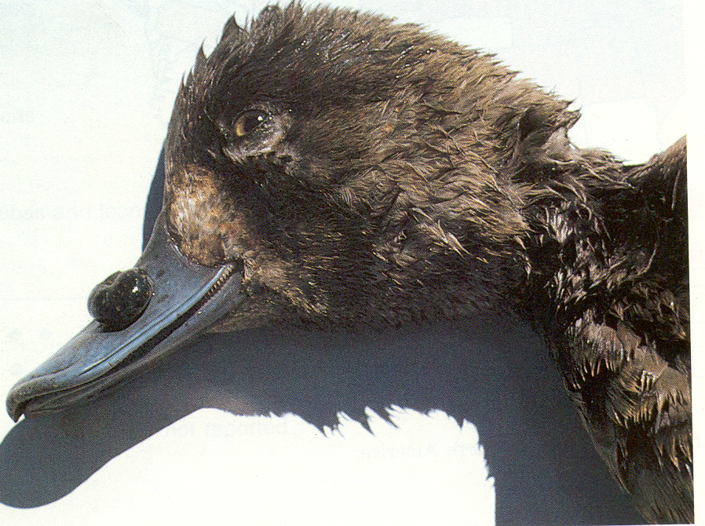
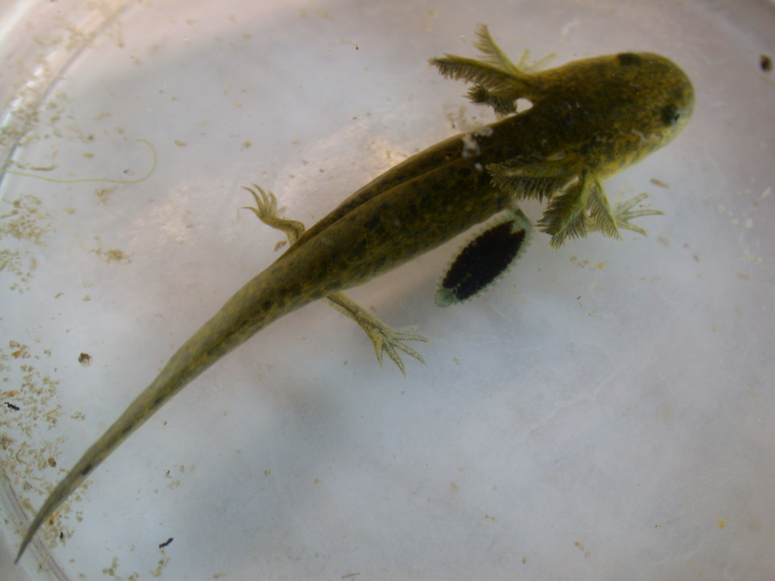
Placobdella picta feed on salamanders and frogs
Theromyzon sp. Feed on the blood of waterfowl in the eyes and nasal passages

Slide 37
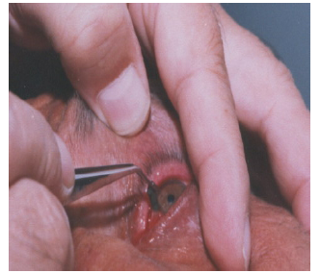

Limnatis nilotica removed from the eye of a 65 yrs-old man from Iran!

Slide 38


Mr. Pro Diver!
Mrs. Pro Diver!

Slide 39


A brooding Glossiphonid leech with its young feeding on my wife’s leg!

Slide 40


Slide 41



Leeches have been used medicinally since the 19th century.
Currently they are used to increase blood flow following reconstructive surgery
Hirudin is a powerful anticoagulant that is found in the salivary glands of leeches
Notes:
1st phyla we will talk about and what we will cover in the lab today is…

Slide 42
The Big Picture
Leeches share some of the same characteristics as Oligo’s and Poly’s
Have obvious suckers
Some leeches are predators on other invertebrates while others are ectoparasites
Still used in medicine today

